Slide 1

Climate Change: Rise and Forecast of Earth Surface Temperature
- Rishi Khimani

Slide 2
Content:
1. Introduction
2. Objective
3. Dataset Description
4. Exploratory Analysis
5. Forecasting
6. Conclusion

Slide 3
Introduction
Mumbai (Bombay), India is the second largest urbanized city in the world, after Tokyo, Japan. Due to rapid urbanization, it has faced the consequences of global warming in the forms of increasing amounts of rains, floods, and sea-levels. As a result of floods, people have been dislocated, the structural stability of buildings have been compromised, and material damage as well as mortality costs have risen.
- Jawale, P., and S. Tandon. “Economic Impacts of Climate Change on Mumbai, India.” Eldis, Jan. 2008, www.eldis.org/document/A56131.

Slide 4
Objective
In this project, we are going to analyze surface temperature rise from 1980 to 2012 and are going to forecast changes in temperature causing adverse effects in Mumbai, India using in-class taught techniques.

Slide 5
Dataset Description
This dataset contains 113 years of climate change observations from across the globe (Dataset source Berkeley Earth data page).Dataset includes the following columns:
1. Date – It is range of date between the year 1900 to 2013
2. Average Temperature – Global average temperature in Celsius
3. Average Temperature Uncertainty – Error value of thermometer (For example if my thermometer reading fluctuates between 20.12 to 20.18, I can conclude my uncertainty would be 0.06)
4. City – Consists of the city name where the weather change occurred.
5. Country – Contains the country name
6. Latitude – Gives the latitude values
7. Longitude – Gives the longitude values

Slide 6
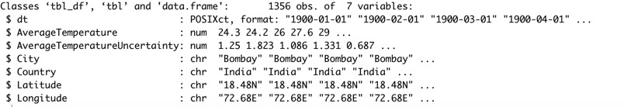
Exploratory Analysis
1. Filtering the data: We have first filtered data for City -> Mumbai, Country -> India from the global dataset.
2. Data Cleaning: We check for missing values in the dataset. Removing all NAs/ null values.

Slide 7
Exploratory Analysis
3.Looking at the data:
The data shows margin trend in terms of temperature rise over the years .

Slide 8
Exploratory Analysis
4. Applying Decomposition:
Size of the seasonal fluctuations seem to increase with the series of time.

Slide 9
Cross Validation
Splitting the Data:
Then we split the data as ‘Test Data’ and ‘Train Data’ to apply our forecasting and model implementation techniques to find ‘Best Fit Model’.

Slide 10
Forecasting (TRAIN Data)
1. Mean: the prediction for unobserved values is the average of the observed values.
2. Naïve: forecasts are produced that are equal to the last observed value
3. Seasonal Naïve: The seasonal naïve method is particularly useful for data that has a very high level of seasonality.

Slide 11
Modelling (TRAIN Data)
ARIMA Modelling

Slide 12
Forecasting

